Slide 1
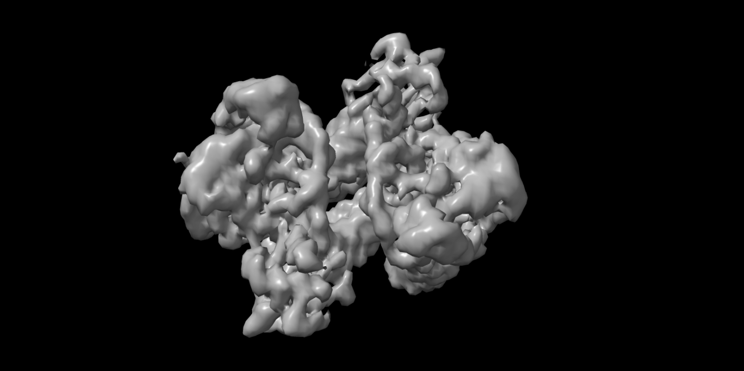
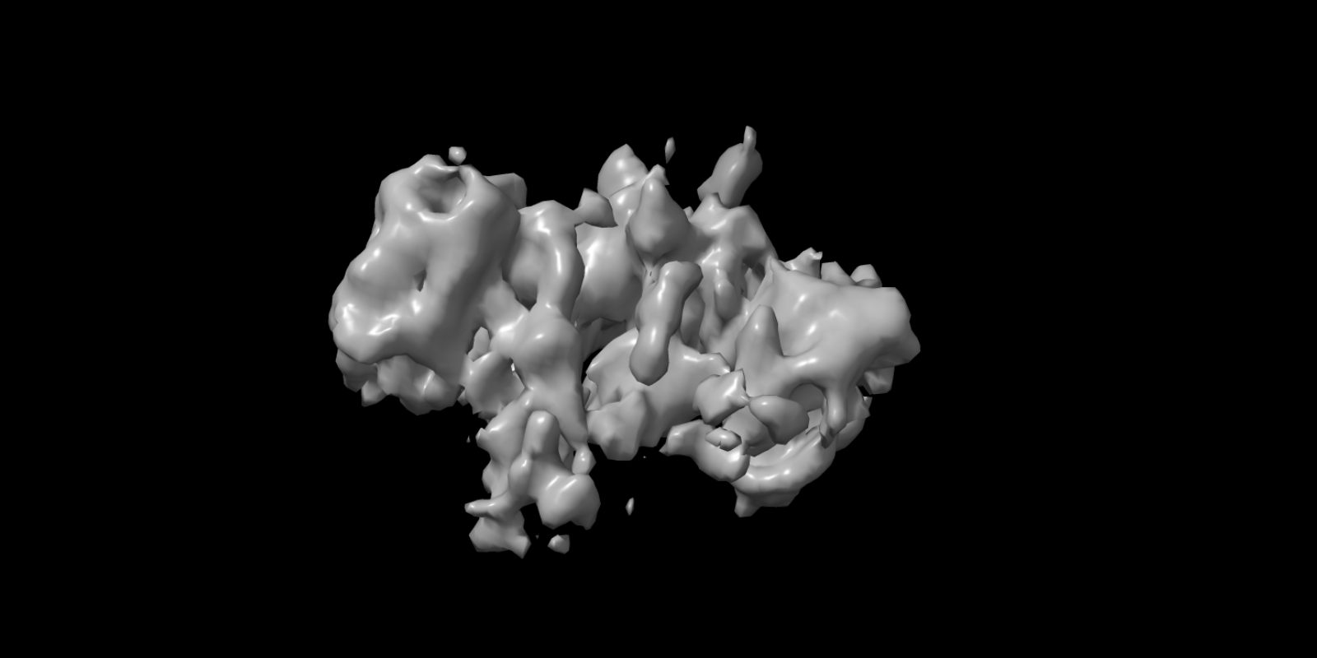
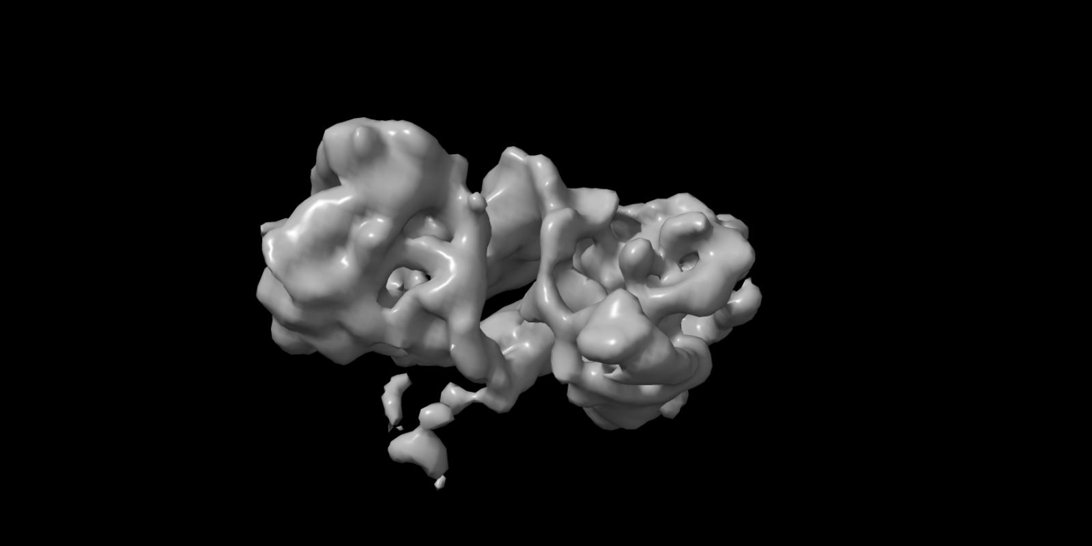
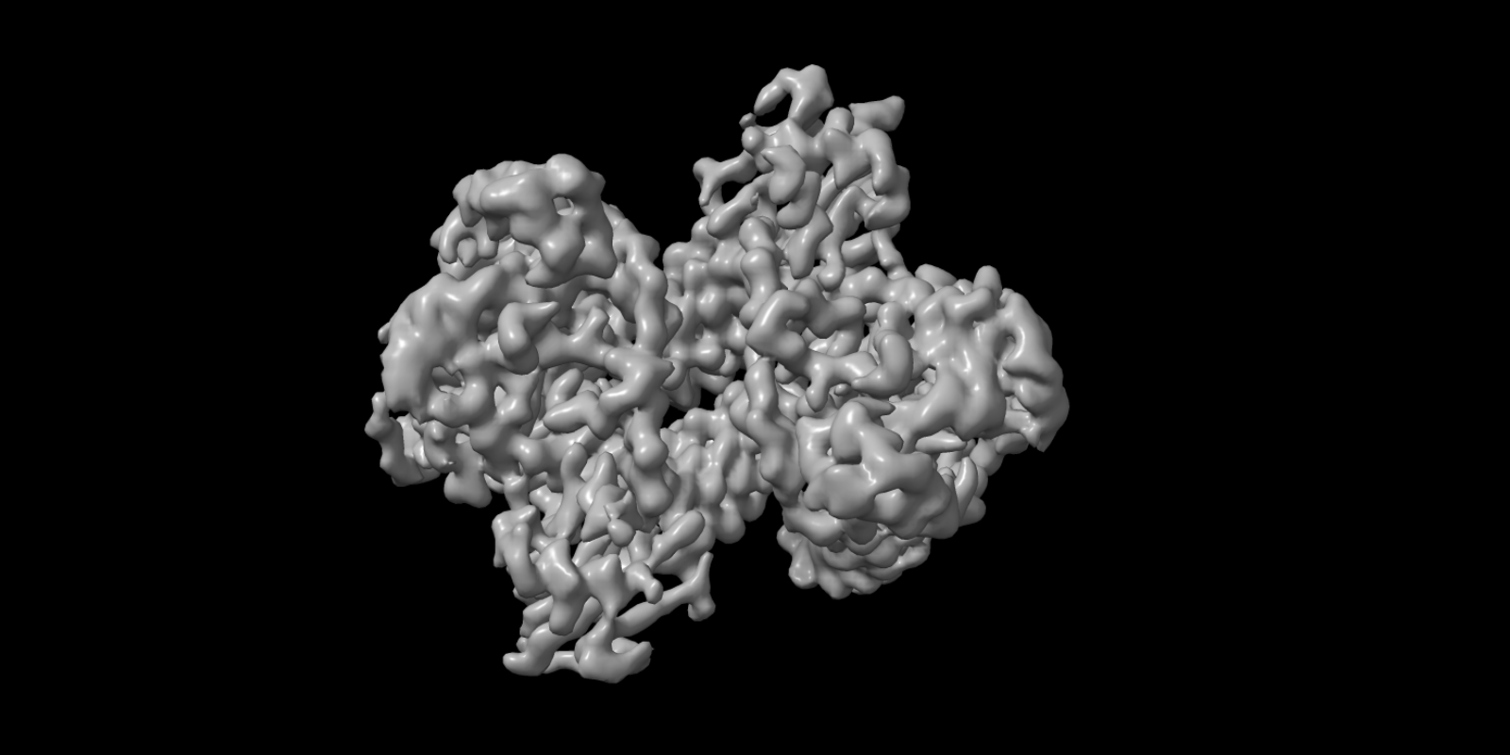

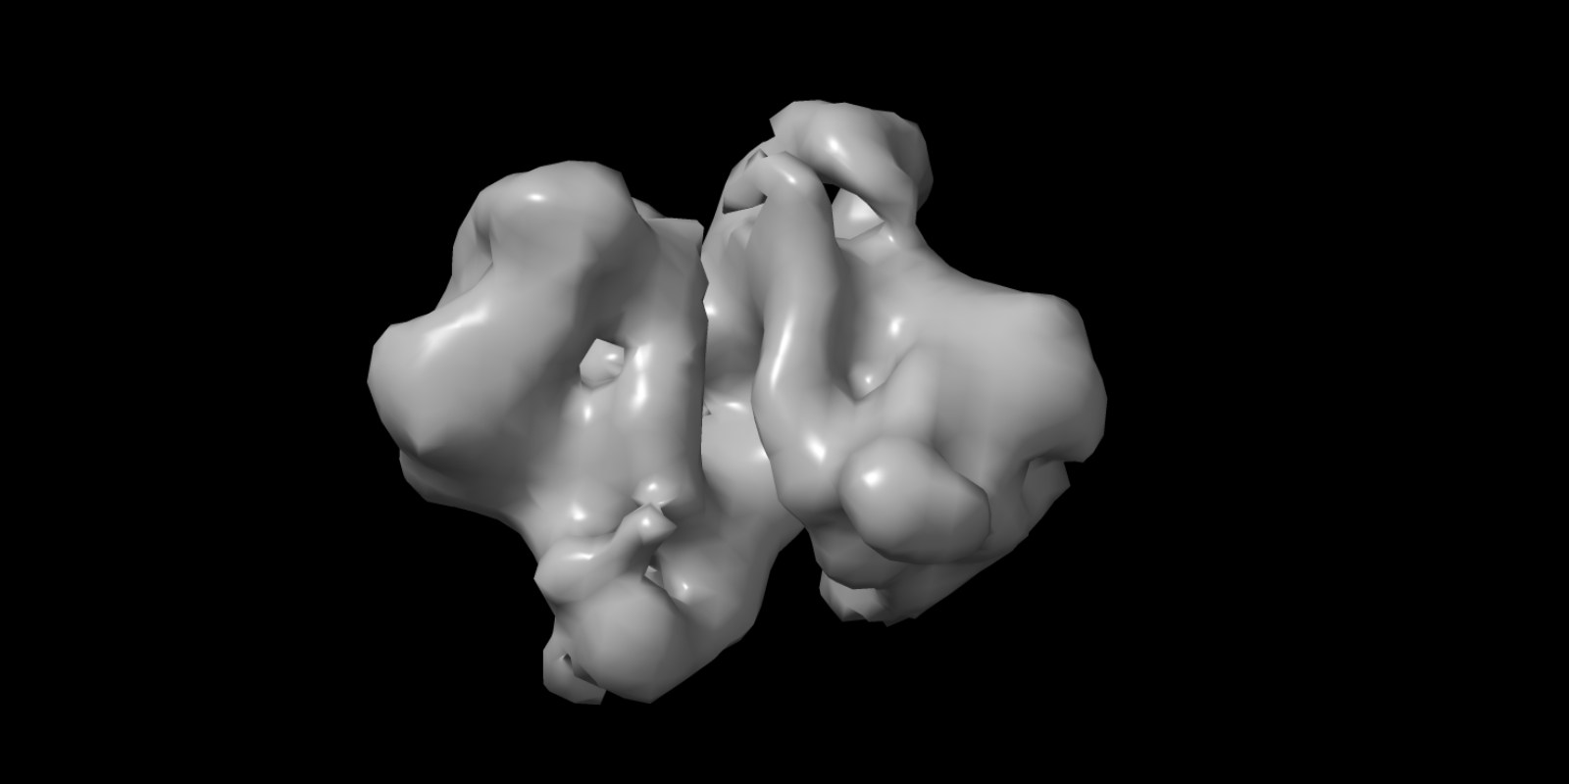
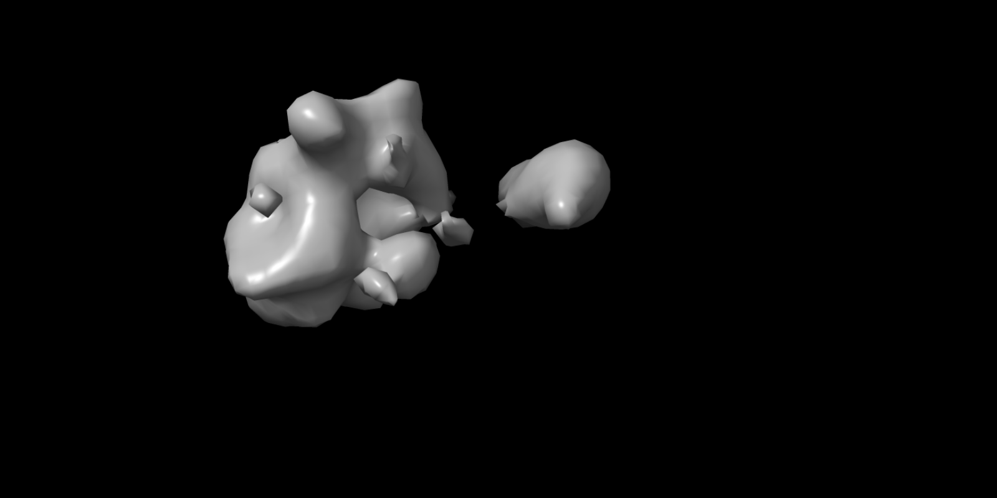
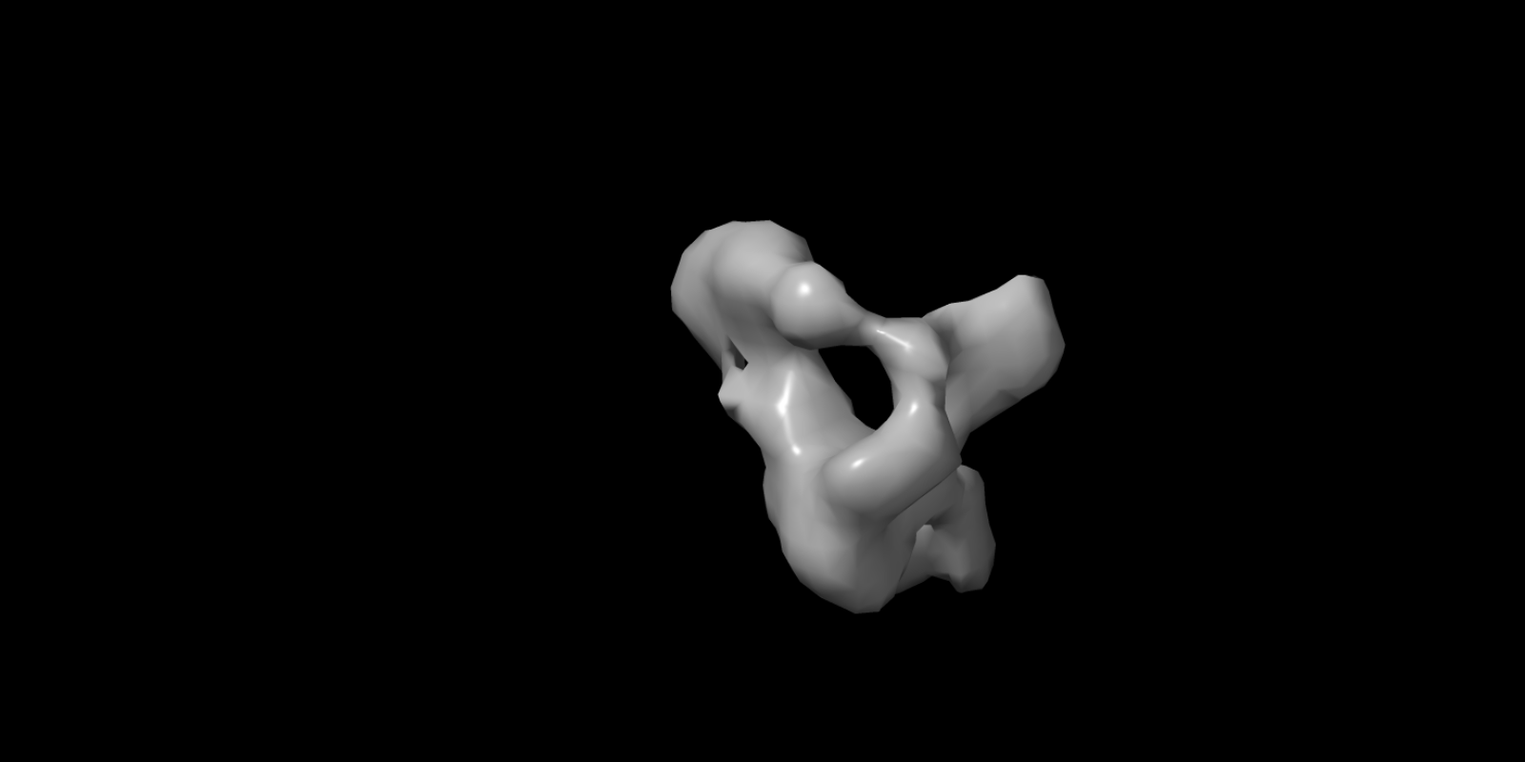
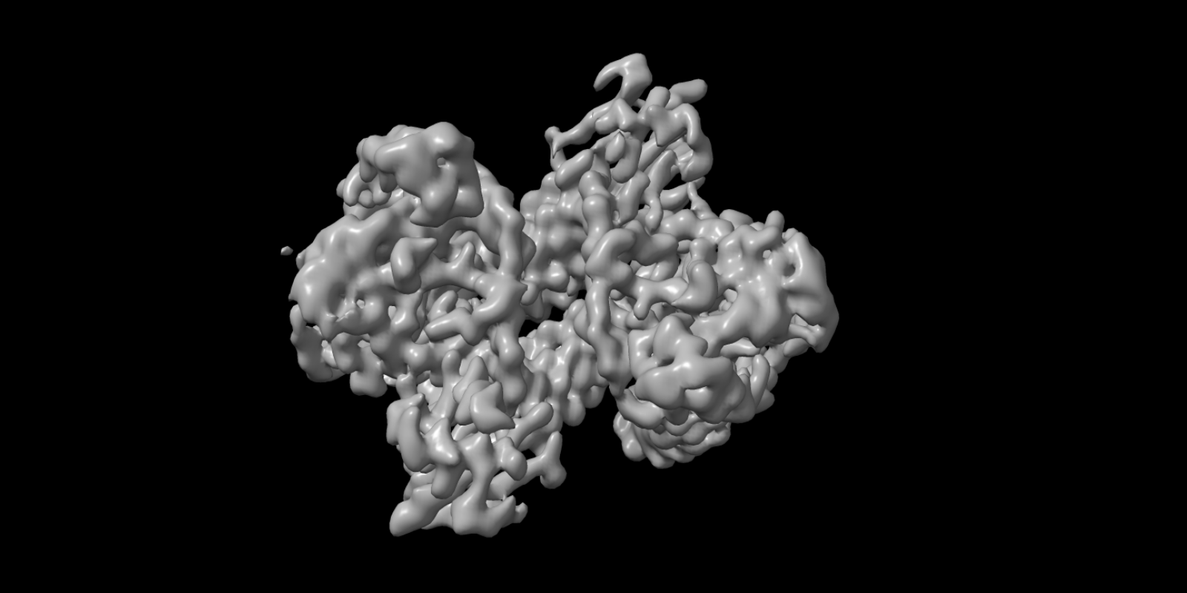


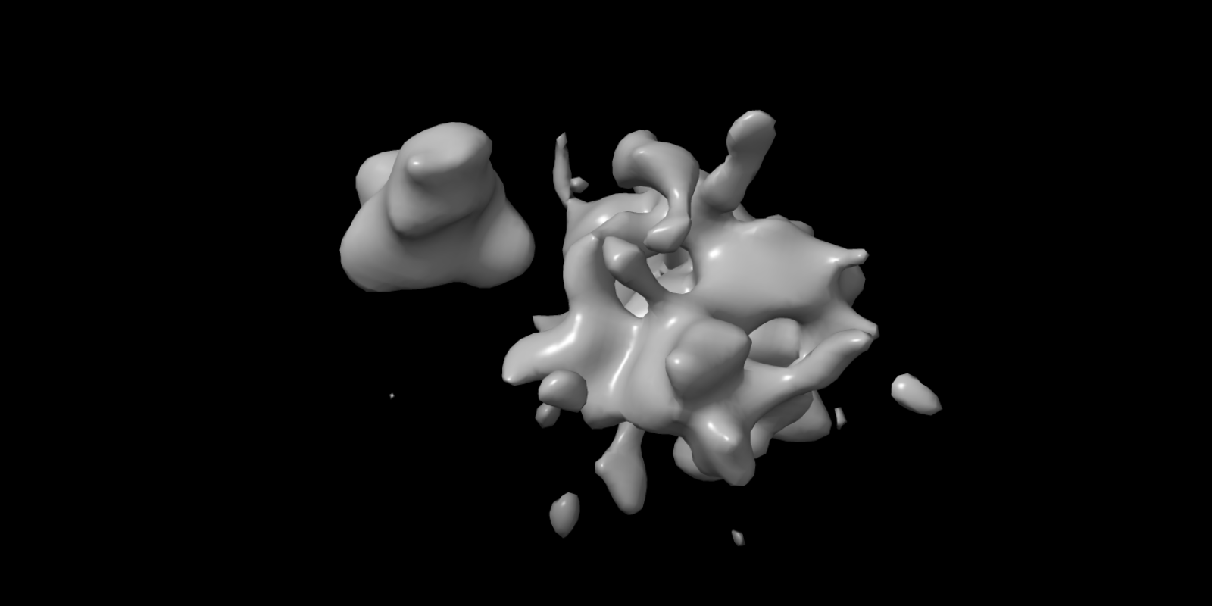
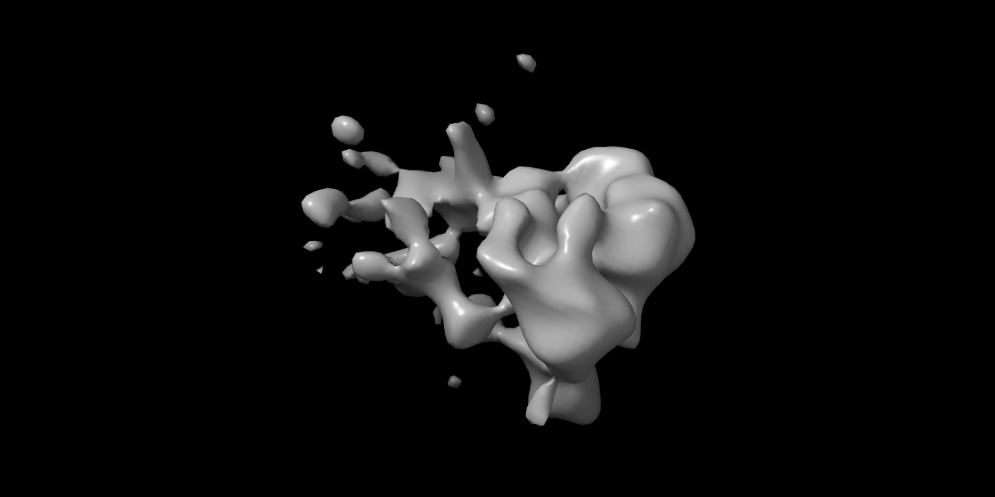
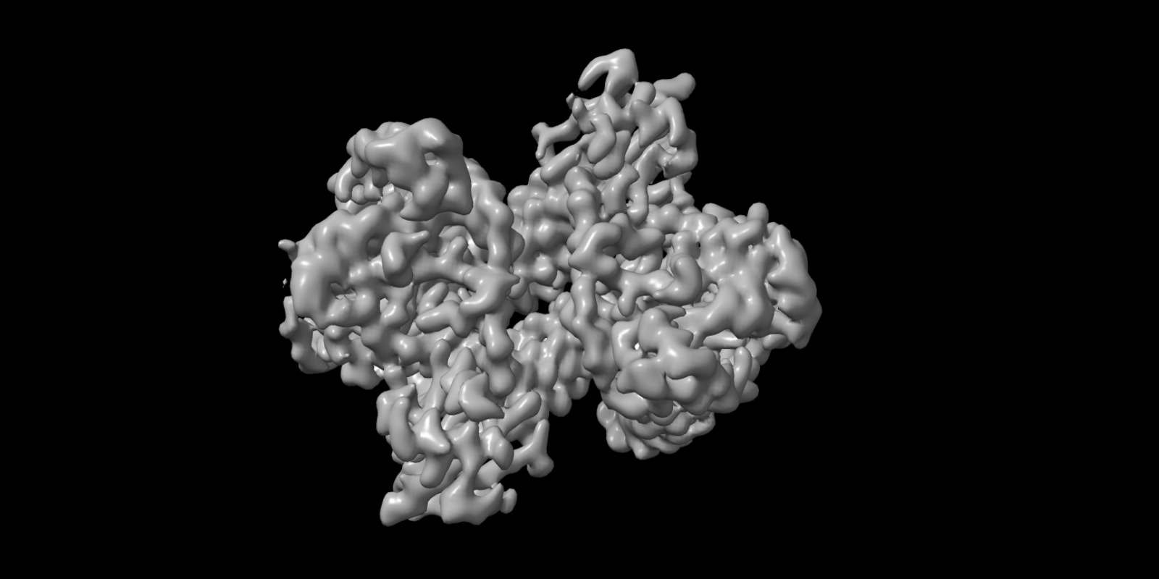
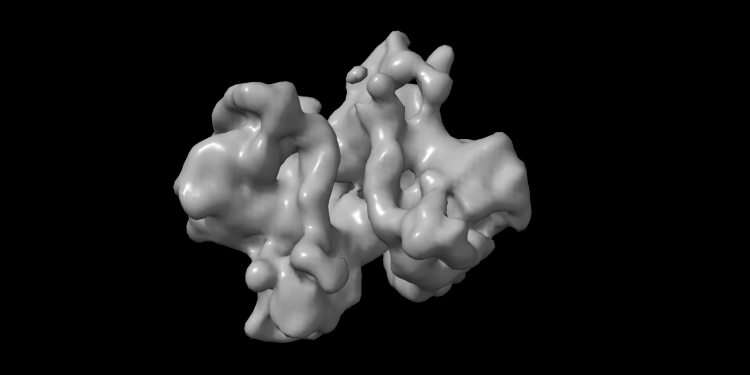
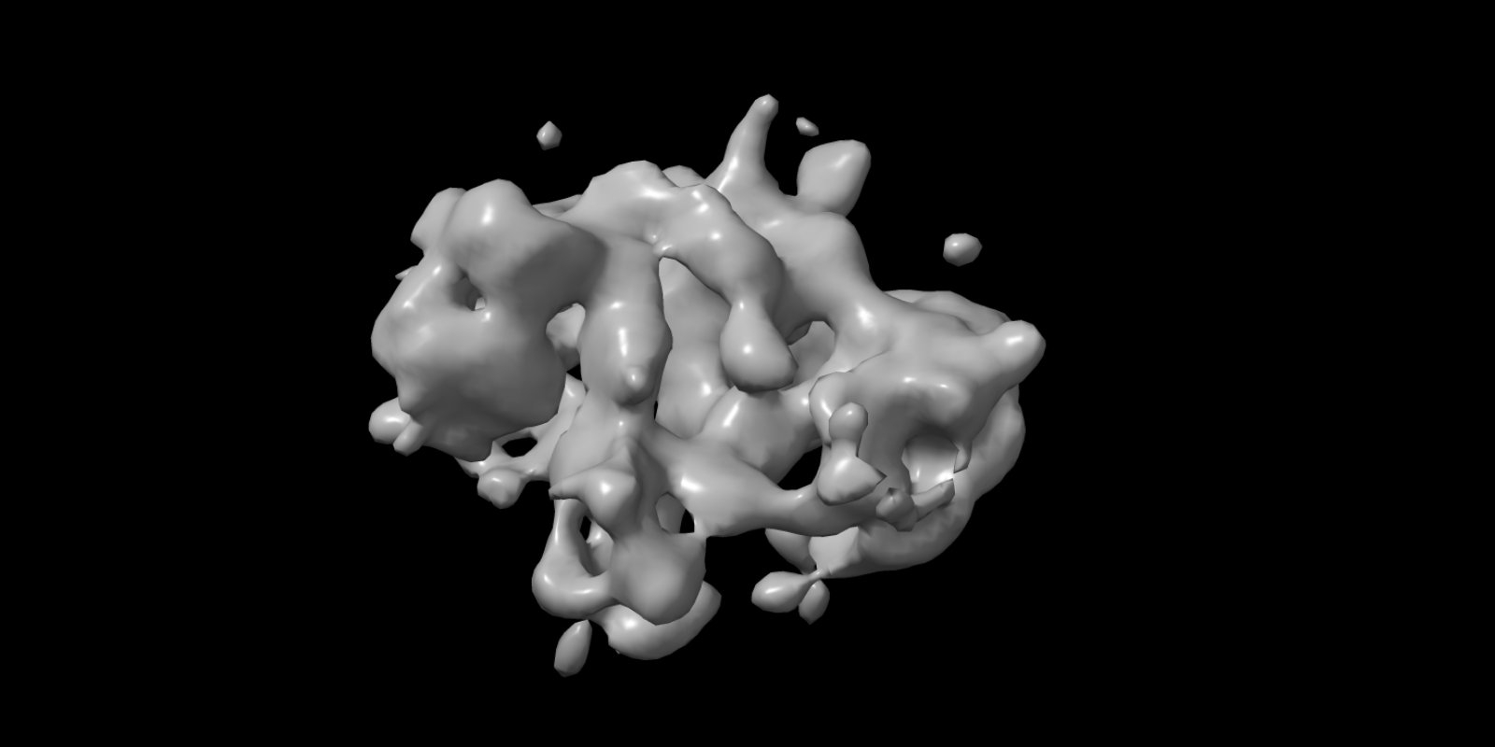
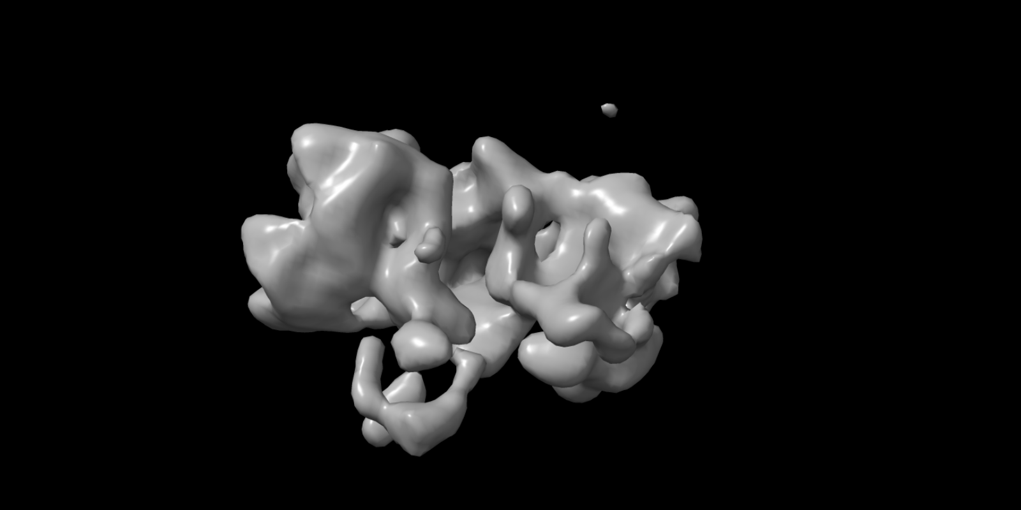
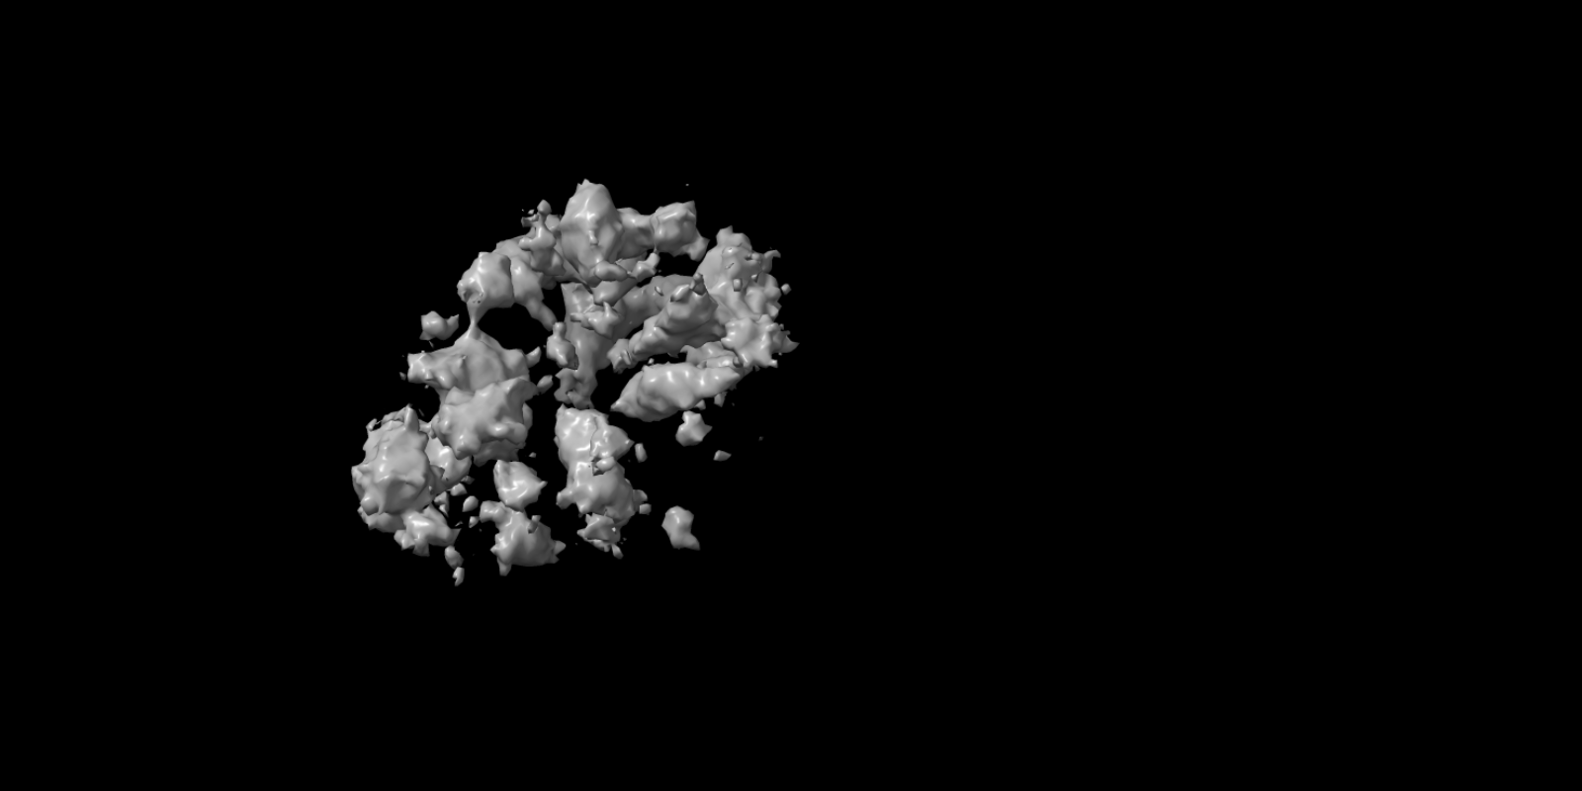
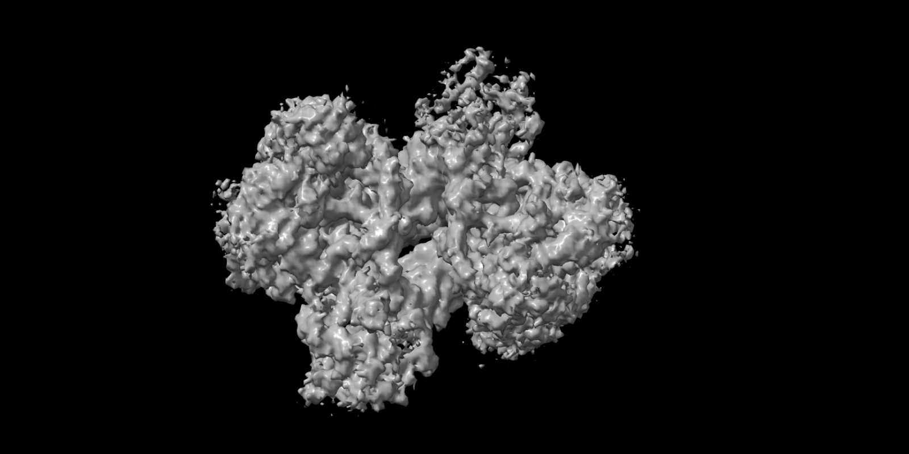
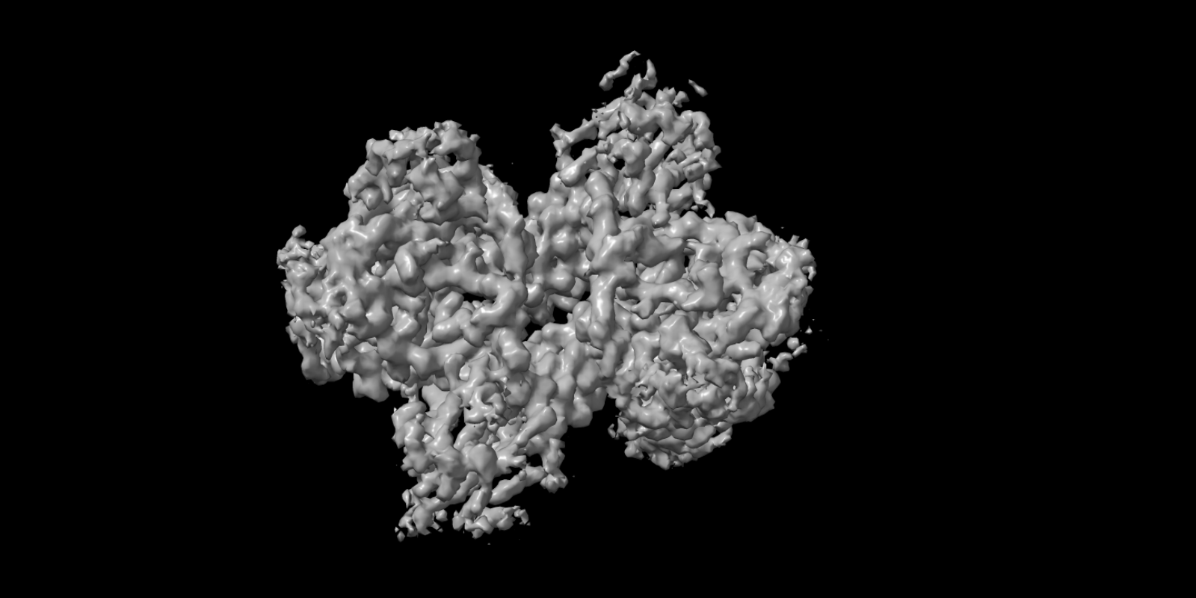
6,060 Micrographs
Auto pick
164,291 particles
2D class selection
Hetero refinement
Homo Reconstruct
12,259 selected
6 classes
209,127 particles
64.1%
378,677 particles
18.6%
109,606 particles
17.3%
102,138 particles
Ab-initio reconstruction
Non-uniform refinement
Local refinement
378,677 particles
209,127 particles
50%
29,004 particles
24.6%
14,299 particles
25.4%
14,745 particles
Hetero refinement
Non-uniform refinement
378,677 particles
77%
590,421 particles
11.8%
90,557 particles
11.2%
85,582 particles
Ab-initio reconstruction
Ab-initio reconstruction
47%
277,687 particles
29.9%
176,548 particles
23.1%
136,186 particles
4.2%
15,755 particles
40.6%
153,795 particles
55.2%
209,127 particles
所有地图已对齐至参考 J41/volume · 手性检查: 4 个已翻正，15 个一致 · 视角 y-90 · CryoSmart Workflow Figure (ChimeraX aligned)

